Slide 1

INSPECTMATE
Simplifying Vehicle Inspection Application
SOFTWARE PRODUCT MANAGEMENT
Assignment #1 - PRODUCT DISCOVERY
Submitted By – Group AA
Hruday Peddula (Student ID: 2023TM93720 )
Pavana Lakshmi P (Student ID: 2023TM93750)
Supriya P (Student ID: 2023TM93755)
Gayathiri V (Student ID: 2023TM93718)

Slide 2

Product Opportunity
We brainstormed product opportunities and below were some identified opportunities
Language Learning App
Smart Home Voice Assistant
Simplifying Vehicle Inspection App
Food Delivery App
On Group voting, “Simplifying Vehicle Inspection App” was chosen
BRAINSTORMING

Slide 3
Product Brief
Application that allows user to do the vehicle inspection using their mobile device from their own location without going to any workshop
Features :
The app will detect the damages present in the vehicle and will give an estimation summary (repair cost) -from which customer can directly analyze the damages and their repair cost even before visiting workshop
Repair cost may not be accurate or what workshop expected -in this case customer provided with the edit option in changing estimate cost
Vehicle rental companies using this application to monitor the rented vehicle (whether any new damages caused by the client rented the vehicle so that they can charge them accordingly -This saves lot more money for the rental company)
This application is using by vehicle insurance company -They are using Man-power to do a vehicle inspection ,using this app the company shall provide a link to the customer and they shall use the link to do inspection from their own space which reduces the Man-power
Not only exterior damages -during the process customer shall give each and every details like fuel level, tyre brands, tyre thread depth level ,condition of the interior section etc.

Slide 4


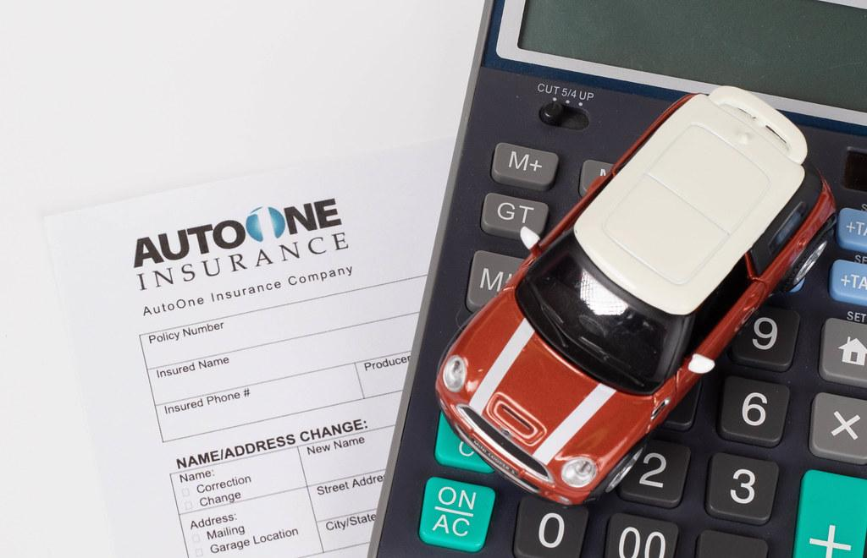

Target Customer Segment/Market
Our software caters to customers who own a vehicle by providing them with a comprehensive and user-friendly platform for repairing, upgrading, and customizing their vehicles
Type 1: Automotive Repair Shops Independent repair shops and franchises specializing in vehicle damage repair. Require efficient processes for assessing, estimating, and repairing vehicle damage |  | Type 2: Vehicle Owners Individuals or businesses owning vehicles in need of repair due to accidents or other damages. Seek reliable and transparent repair services for their vehicles.
Type 3: Insurance Companies Insurance companies may require vehicle inspections as part of the underwriting process to assess risk and determine insurance premiums |  | Type 4: Fleet Managers Companies with vehicle fleets, such as rental car companies, taxi services, delivery companies, and transportation businesses, require regular inspections to maintain the safety and reliability of their vehicles

Slide 5
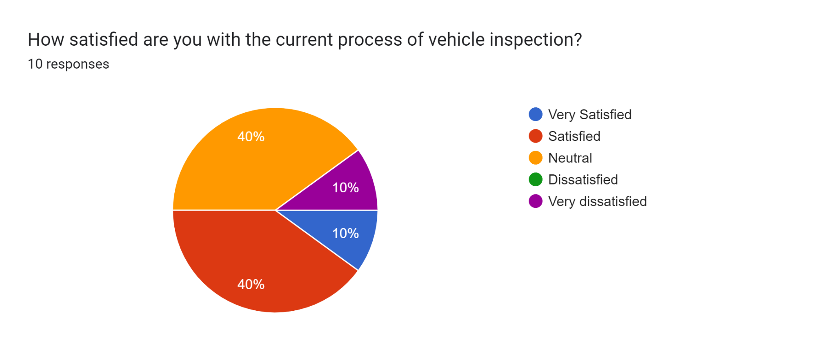
Customer Survey Outcomes (1)
Google Forms survey has been created to gather customer inputs and pain points. Survey Outcomes are captured.
Feedback form link
Total of 10 customer responses

Slide 6
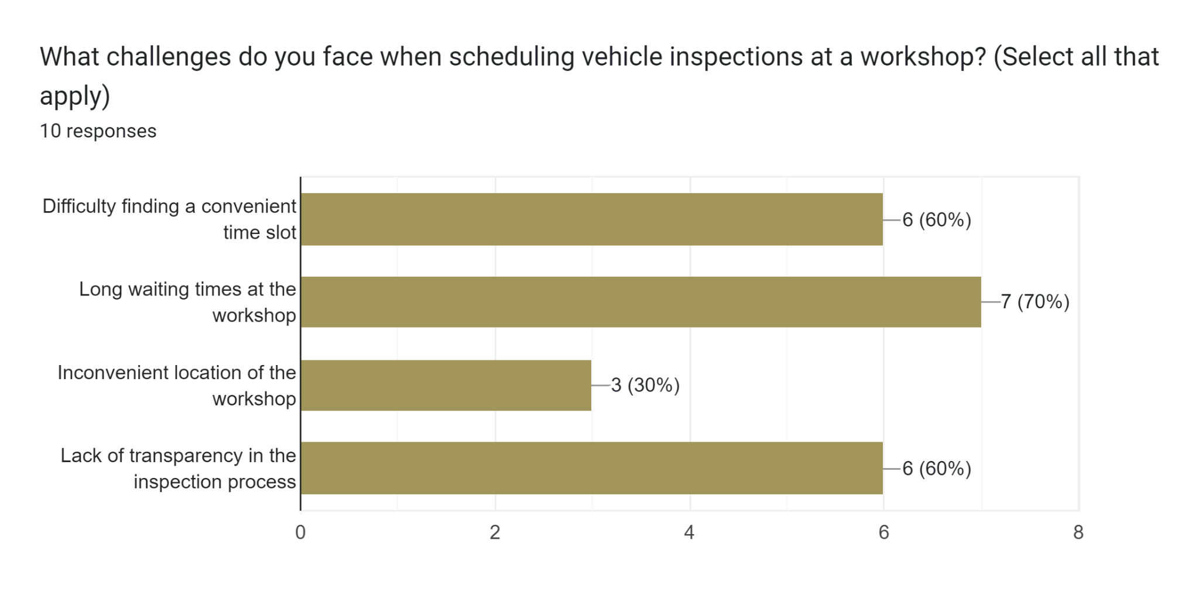
Customer Survey Outcomes (2)
Google Forms survey has been created to gather customer inputs and pain points. Survey Outcomes are captured.
Feedback form link
Total of 10 customer responses

Slide 7
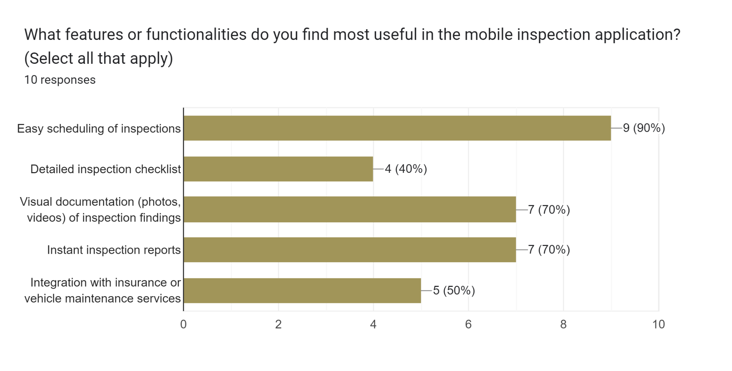
Customer Survey Outcomes (3)
Google Forms survey has been created to gather customer inputs and pain points. Survey Outcomes are captured.
Feedback form link
Total of 10 customer responses

Slide 8
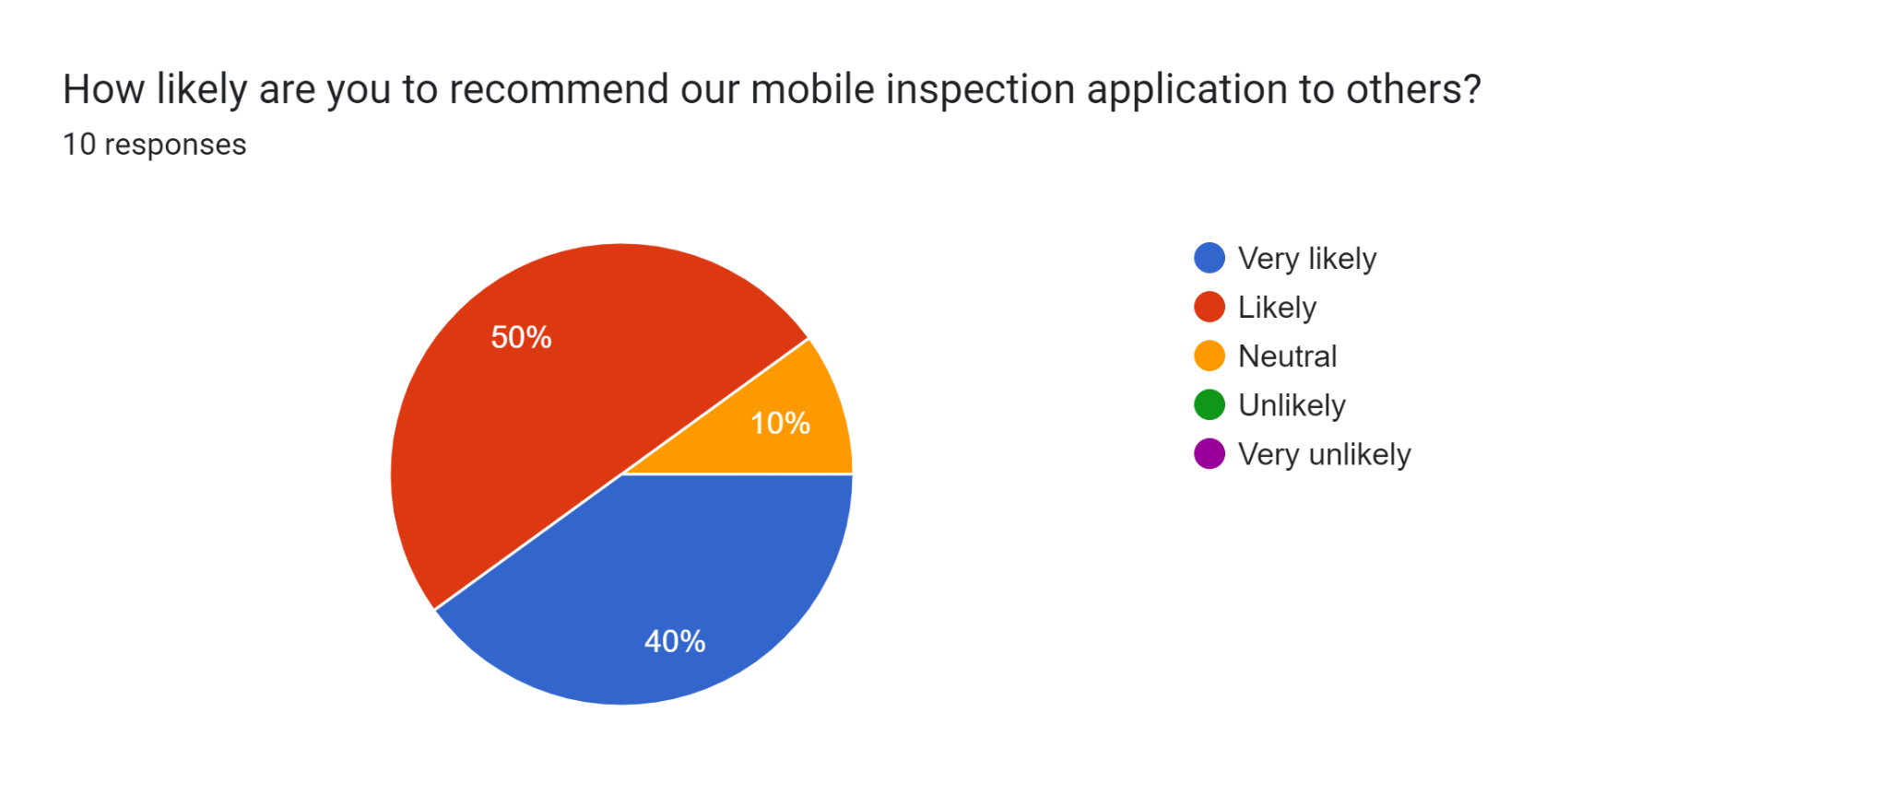
Customer Survey Outcomes (4)
Google Forms survey has been created to gather customer inputs and pain points. Survey Outcomes are captured.
Feedback form link
Total of 10 customer responses

Slide 9






Key Pain Points
Time Consuming Process:
Inspections often take a significant amount of time, especially if there’s a long queue or if the inspection is thorough.
Inconvenience:
Having to take time out of the day to bring the vehicle in for inspection can be inconvenient, especially if it requires taking time off work or rearranging schedules.
Lack of Transparency:
Some Vehicle owners may feel that the inspection process is opaque, with little explanation provided about what is being checked and why.
Regulatory Compliance:
Inspectors may struggle to keep up with changing regulations and standards, leading to confusion and potential compliance issues.
Technical Issues:
Inspectors may encounter technical difficulties with equipment or software used during the inspection process, leading to delays and frustration.

Slide 10
Value Proposition
Product | Key Pain Points | How Does it Solve | Benefit/Value Proposition | Differentiation from Competition
INSPECTMATE (Simplifying Vehicle Inspection App) | Time-consuming process: Vehicle Inspections often take a significant amount of time, especially if there's a long queue or if the inspection is thorough Lack of transparency: Some vehicle owners may feel that the inspection process is opaque, with little explanation provided about what is being checked and why. Lack of documentation about customer feedback | Online Application that allows customer to do vehicle inspection using their mobile devices from their own location without going to any workshop The inspection details can be shared to customer in the format of pdf / hyperlink Customers satisfaction rate is measured with reviews/ratings | Saves time for customers in few clicks with user guide images Cost Effective E2E Damage detection (Interior/Exterior) Regulatory compliance followed by vehicle inspectors are Up-To-Date | Low / Best cost provider Video based image identification feature of the vehicle damages Online vehicle inspection capability at the comfort of customer Continuous improvements based on customers reviews/ratings

Slide 11
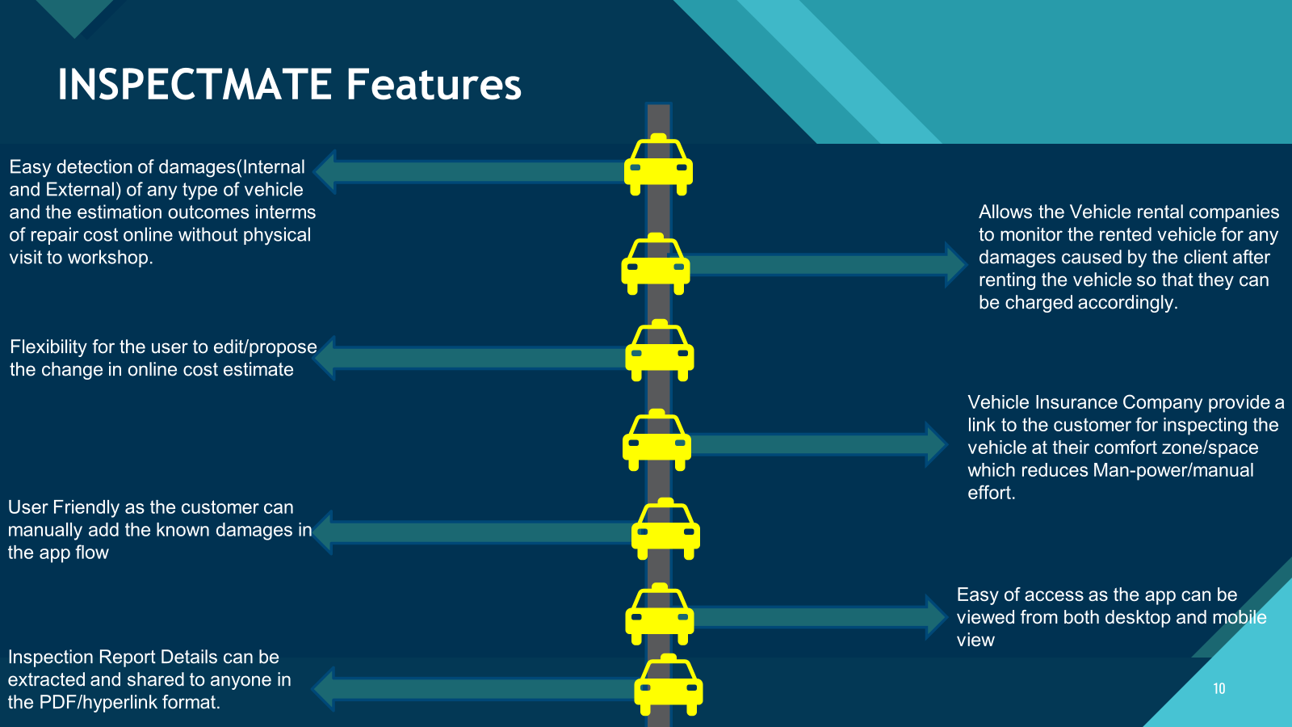
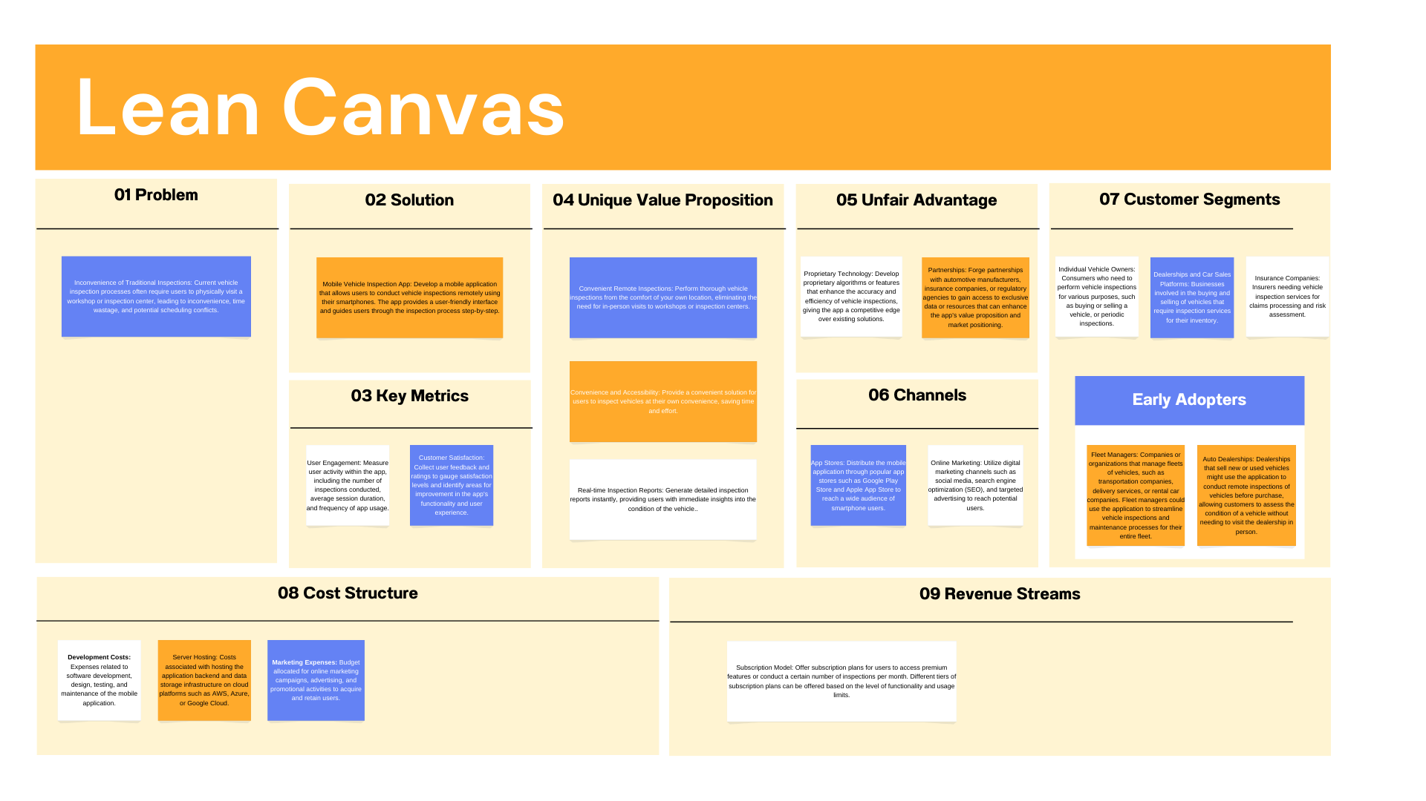

Slide 12
Story Map
User access to the site
Vehicle Inspection
View Inspection History
Vendor Search
Customer Support
User Activities
(Backbone)
Login
Create an account
Perform Vehicle Inspection
Complete Inspection Checklist
Report Generation
Access Inspection History
View History
Avail vendor services
Access Support
User Tasks
(Skeleton)
Username/ email address and password
Fill mandatory details
Select the vehicle to inspect
Review pre-defined checklist items.
Review checklist results and photos.
Navigate to inspection history section.
Select an inspection to view details.
Appointment for damage inspection
Access Help Center
RELEASE 1
Authenticate
Create password
Tap on vehicle to proceed.
Mark each item as pass, fail, or needs attention.
Generate report.
View list of previous inspections.
Review checklist results, photos, and report.
Track damage inspection progress
Submit Support Ticket
Register
Capture photos of any issues or damage found during inspection.
Add comments or photos for each item.
Share report via email or messaging.
View Support History
Share damage parts with vendors
User
Stories
Biometric authentication to login
Annotate photos to highlight specific areas.
Capture signature for inspection approval.
Generate report with signature included.
Initiate a live chat session with customer support.
Schedule pick up & drop from vendor
Video based image identification of damages
Save signature for future reference.
Communicate with support agent to resolve issues or ask questions.
RELEASE 2
Customer rating/reviews

Slide 13
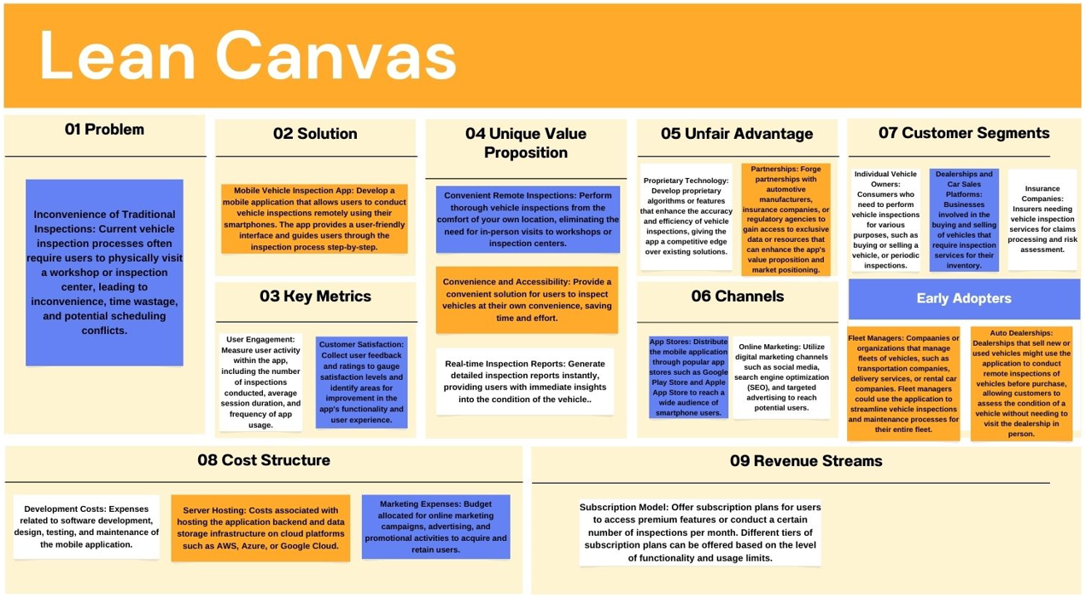
Business Plan

Slide 14





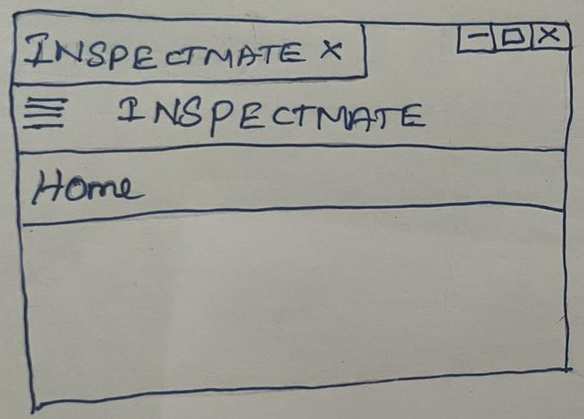
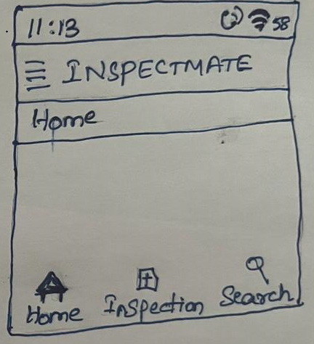
INSPECTMATE – HOMEPAGE SKETCH
Homepage displays the Vehicle Inspection details along with the details – Status, Date, Inspected by and few more.
Desktop View
Mobile View

Slide 15
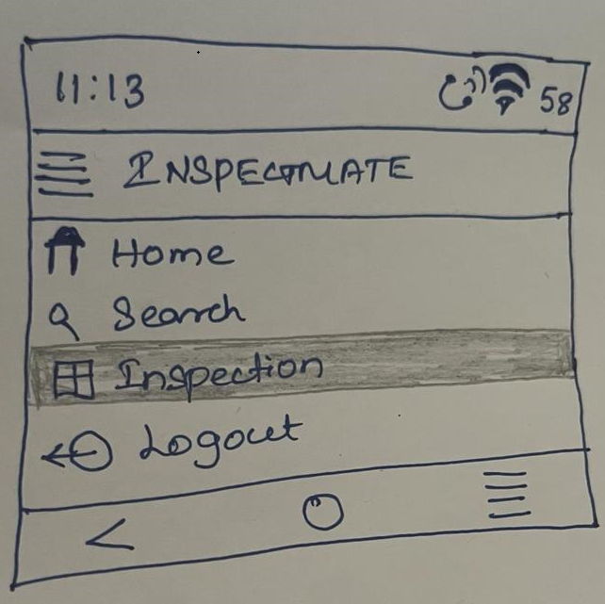
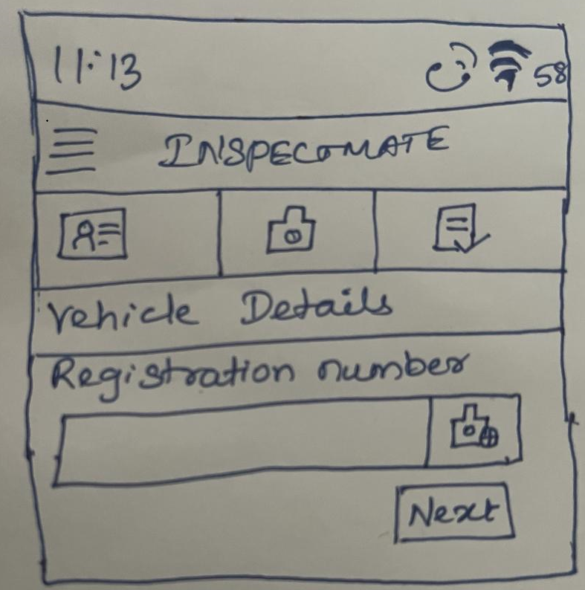
INSPECTMATE – INSPECTION PAGE SKETCH
Customer can click on the “Inspection” tab from hamburger menu to start the inspection.
Customer is prompted to enter the vehicle registration number.
Customer can also capture the image of the License plate from where the model detects the Registration number.
Clicking on next , Customer is prompted with details – Customer Details, Vehicle Make, Model which will automatically retrieve the body style of the vehicle, camera gets activated to capture the picture of the vehicle for the app to determine the damages.

Slide 16
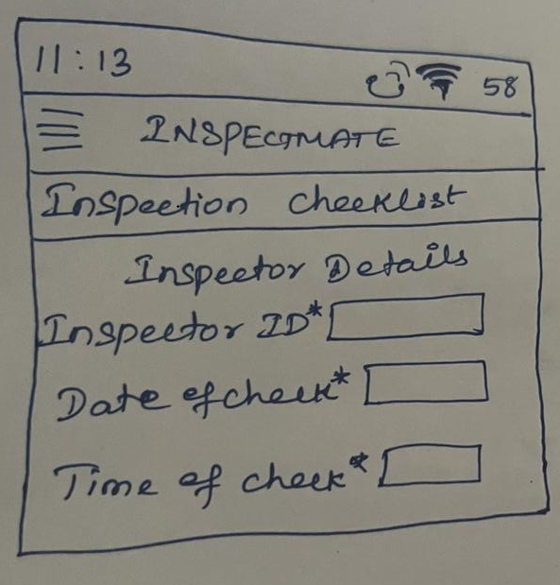
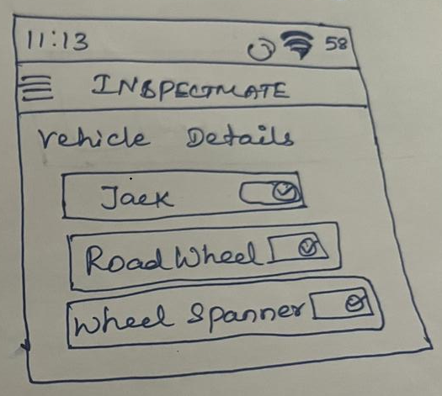
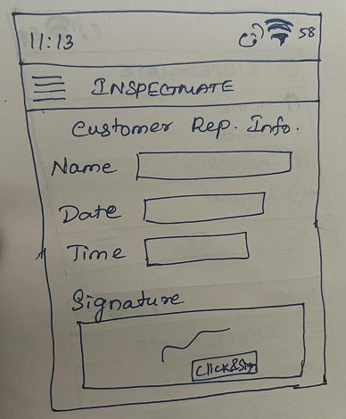
INSPECTMATE – CHECKLIST PAGE SKETCH
Once the vehicle details are entered, checklist gets displayed for the customer to verify the inspector, vehicle details and approve to the next steps.
INSPECTOR DETAILS
VEHICLE DETAILS
CUSTOMER REP. DETAILS

Slide 17
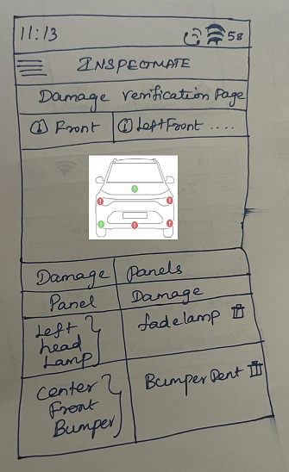
INSPECTMATE – DAMAGE VERIFICATION PAGE SKETCH
Customer is directed to Damage verification page where use can manually assess the damage whether the detected damage is correct or not and they can add/delete the damage.

Slide 18
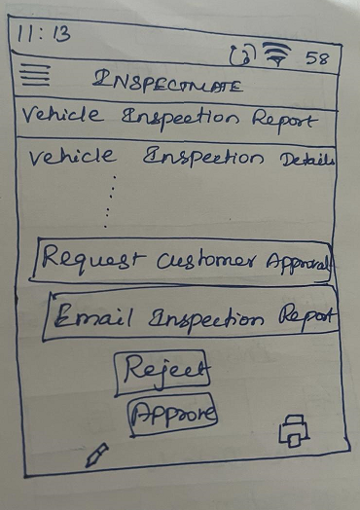
INSPECTMATE – VEHICLE INSPECTION REPORT PAGE SKETCH
Once the customer clicks on complete button, the application will direct to Vehicle Inspection Report page where Request Customer approval can be used if there is a delay, Email Inspection Report, Approve/Reject by the customer online.

Slide 19
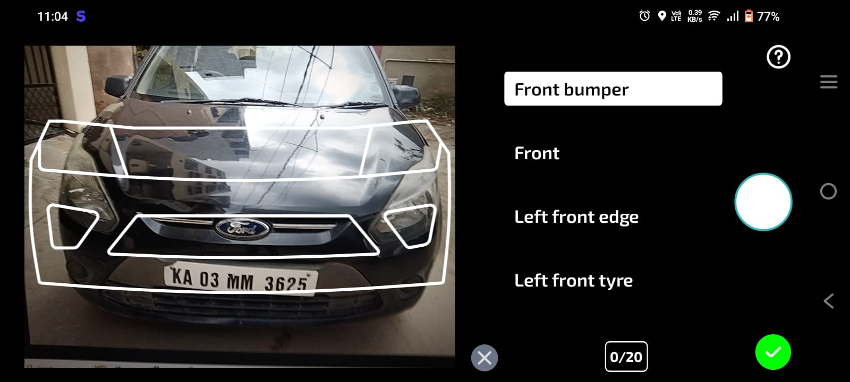
INSPECTMATE - STORYBOARD

Slide 20
Key Learnings
User Needs Identification: Understanding the primary pain points and needs of vehicle owners regarding inspection processes.
Market Research: Analyzing existing solutions and competitors in the vehicle inspection app market to identify gaps and opportunities.
Lean Canvas: Creating a Lean Canvas provided a concise overview of the app's key components, value propositions, and revenue streams, facilitating alignment within the team.
Problem-Solution Fit: Iteratively refining the problem-solution fit through customer interviews and feedback ensured that the app addresses real user needs effectively.
Feature Prioritization: Prioritizing features based on user needs, feasibility, and business goals ensured the app's development stayed focused and aligned with the core value proposition.
Storyboarding: Storyboarding enabled the visualization of user interactions with the app, helping to identify potential usability issues and refine the user interface.

